Slide 1
EDUCATIONAL CERTIFICATES

Slide 2
I have been offered residency in the state of Maine, what do I do?
You first need to apply for an Educational Certificate.
You can find the application at: http://www.fsmb.org/licensure/uniform-application/

Slide 3
What is an educational certificate?
An Educational Certificate is for physicians who are in ACGME approved postgraduate training (residency) in Maine. It is only valid at the hospital system administering the residency. This license is site and date specific.

Slide 4
What will I need to obtain my educational certificate?
A completed application using the Uniform Application (UA)
Completion and passage of the Maine Jurisprudence Examination
Complete addendum online
A letter from the residency program that states the dates you will be training with them.
A notarized copy of your diploma or Dean’s letter if the diplomas haven’t been issued yet.
A check for the amount due. $100/year
A properly notarized affidavit

Slide 5
WHAT IS THE Maine Jurisprudence Examination ?
The State of Maine Jurisprudence Examination is an open book exam that must be passed with a score of 75% or greater.
The review material may be reviewed at: https://www.maine.gov/md/sites/maine.gov.md/files/inline-files/Exam_Study_Guide_07_08_15.pdf
The exam may be taken at:
https://www1.maine.gov/cgi-bin/online/licensing/begin.pl?board_number=376

Slide 6
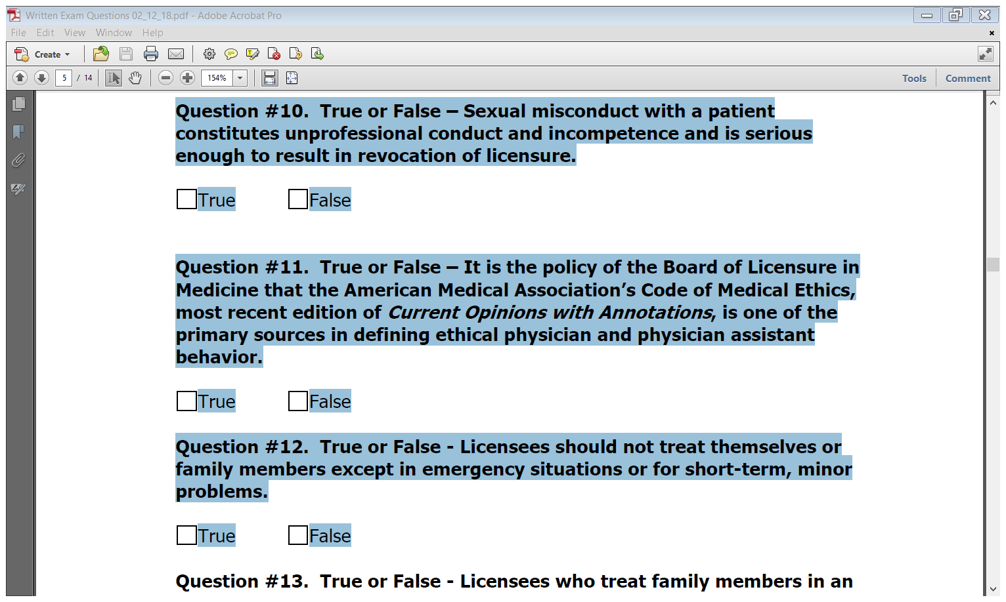
Exam sample

Slide 7
What are the restrictions of an educational certificate for practicing?
You may only practice medicine within the approved residency program hospital system.
This certificate is site specific and does not allow moonlighting.

Slide 8
Are there any special considerations for full licensure if I train in the state of Maine?
You will be eligible to apply for full licensure with 24 months of completed ACGME training in this state.

Slide 9
What are the requirements to get the full license after 24 months of training?
You will need to continue in the residency for at least the full 36 months.
You will need a letter of endorsement from your program director that supports full licensure.
You will need to provide any additional information that may be requested by the board.
Completed FCVS profile
Uniform application (UA)
Maine online addendum
$700 application fee

Slide 10
I was terminated from the residency program, what should I do?
Your license and registration are your responsibility, you must notify the board as soon as possible.
You will need to supply a full explanation in writing of the basis for the termination.
Your residency program must also notify the board.

Slide 11
Can I have someone else fill out my application for me?
No, submitting or having an application submitted that you did not complete entirely could be considered for fraud and deceit in application. This could result in fines, citations and/or possible disciplinary action.

Slide 12
WHAT IS THE PROCESS OF COMPLETING AN APPLICATION?
Step 1.
Complete the Uniform Application (UA) at: https://www.fsmb.org/uniform-application/
Step 2.
Watch for an email from noreply@maine.gov with the instructions for the next 2 steps in completing your application:
1. Complete the Jurisprudence exam online with the log in information sent to you in the email.
2. Complete the online addendum and mail the application fee of $100/year.

Slide 13
How soon will the application be reviewed?
Upon receipt of payment
The applicant will be notified via email of any outstanding items

Slide 14
WHAT ARE SOME AVOIDABLE DELAYS?
Make sure the application is complete, if mailed in, the addendum must be signed.
Have the Dean’s letter or Notarized copy of the diploma submitted
Make certain the Affidavit page is completed and notarized correctly.

Slide 15
AFFIDAVIT DOS AND DON’TS

Slide 16
1. Incorrect…not notarized

Slide 17
2. INCORRECT…Not signed by the applicant

Slide 18
3. CORRECTLY DONE…Seal is on photo

Slide 19
4. Incorrectly done…Stamp is covering the face

Slide 20
UA introduction

Slide 21
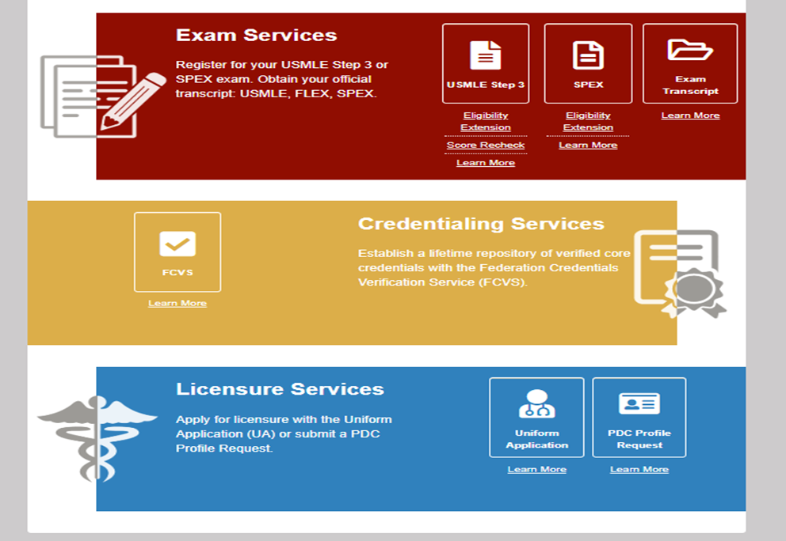
Sample UA – Access UA
Notes:
The UA portal is accessible from the FSMB sing in page. The UA icon is located on the bottom right hand corner of the screen.

Slide 22
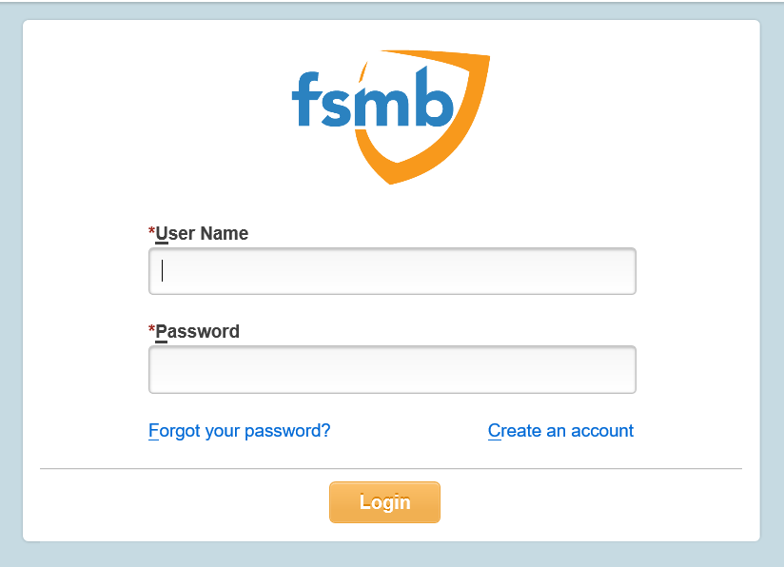
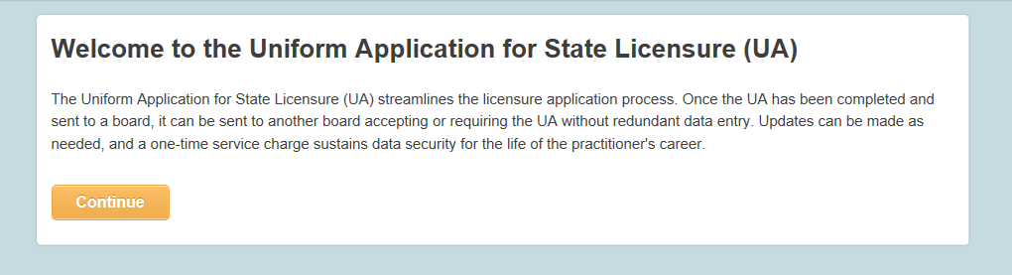
Sample UA – Sign In
Notes:
The sign in section becomes available immediately after selecting the UA option. The physician is able to login or create an account from the sign in page. Upon logging in, the applicant receives a welcome message with a brief explanation of the UA.

Slide 23
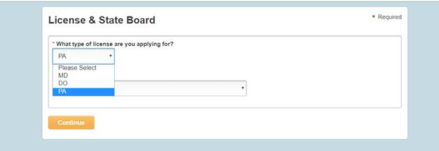
Sample UA – State Instructions/Addendum
Notes:
The applicant will select the type of license for which he or she is applying (MD, DO or PA).

Slide 24
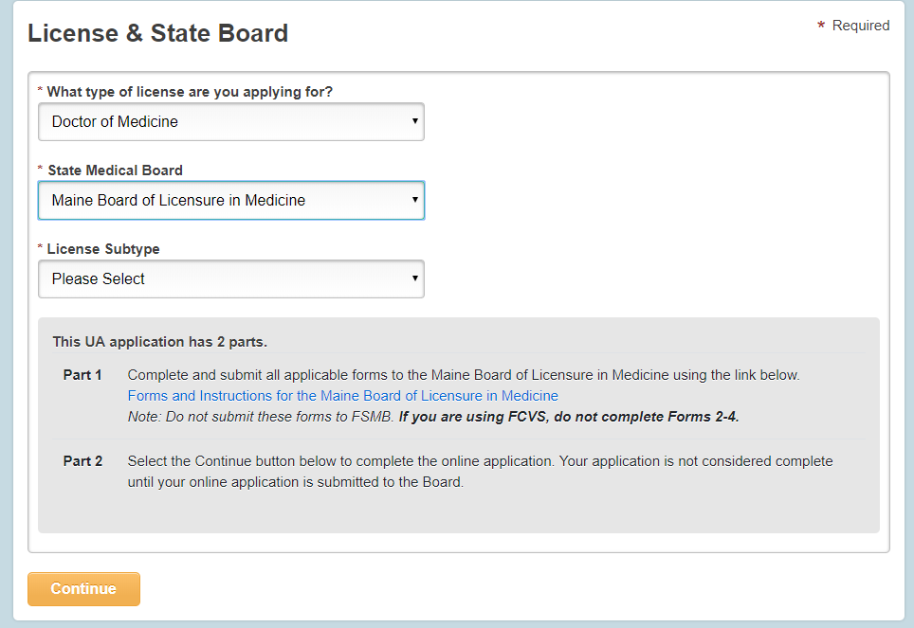
Sample UA – State Instructions/Addedum
Notes:
Only boards which accept the UA for the specified license type are selectable from the dropdown menu. Once a board is selected, the State specific instructions and addendum as well as verification forms are available via link.

Slide 25
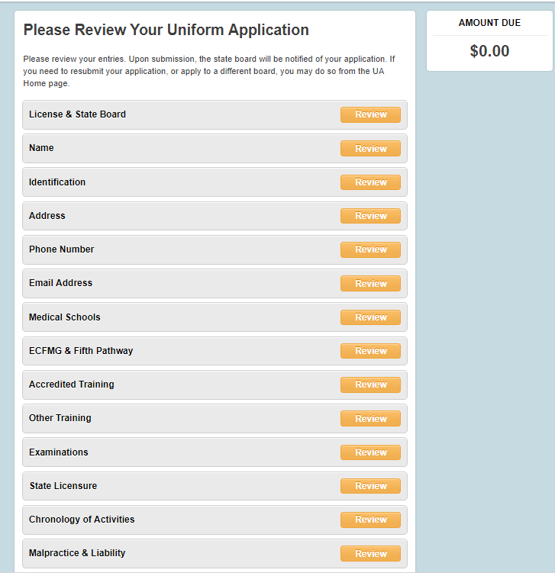
Sample UA – Online Data
Notes:
As you know, FSMB collects data about physicians from a number of sources including USMLE Step 3 applications, FCVS application and licensure files. Any information previously reported will be displayed for the applicant which reduces the data entry required. By clicking the review yellow button next to each section of the application, the system expands and allows the applicant to review, edit and add new information.

Slide 26
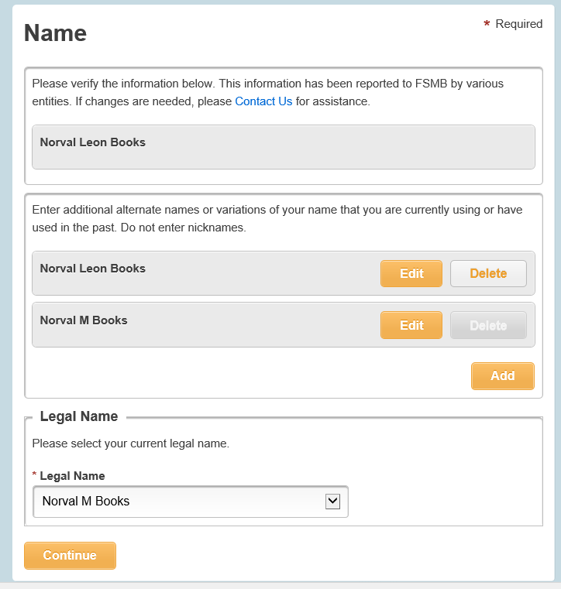
Sample UA – Name Section
Notes:
In the name section, the applicant would enter any name variations if applicable.

Slide 27
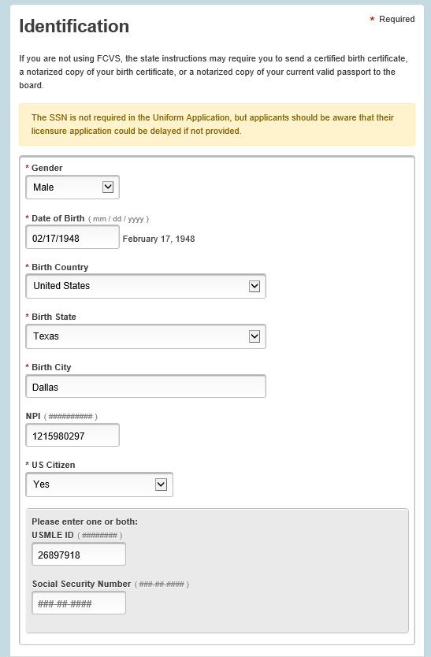
Sample UA – Identification Section
Notes:
The Identification section collect personal data such as:
Gender, date of birth, birth place, NPI number, US Citizenship status, USMLE number and the social security number.

Slide 28
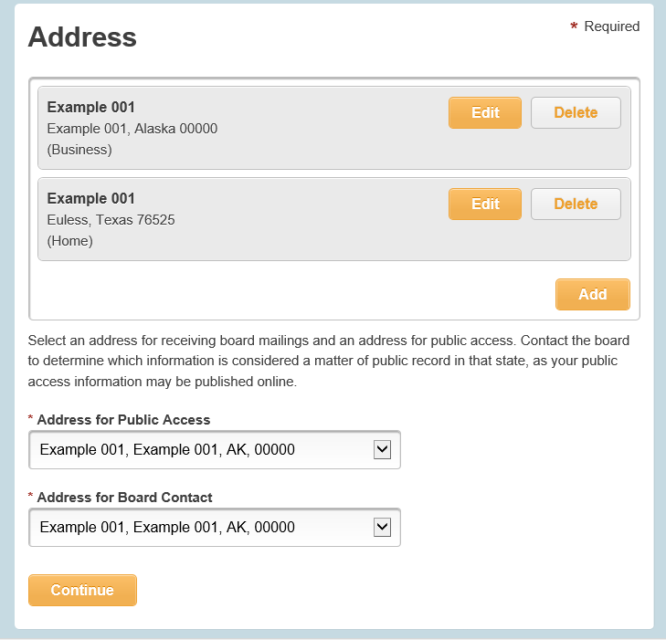
UA Sample – Address Section
Notes:
The address section requires two types of contact information; address for public access and board contact.

Slide 29
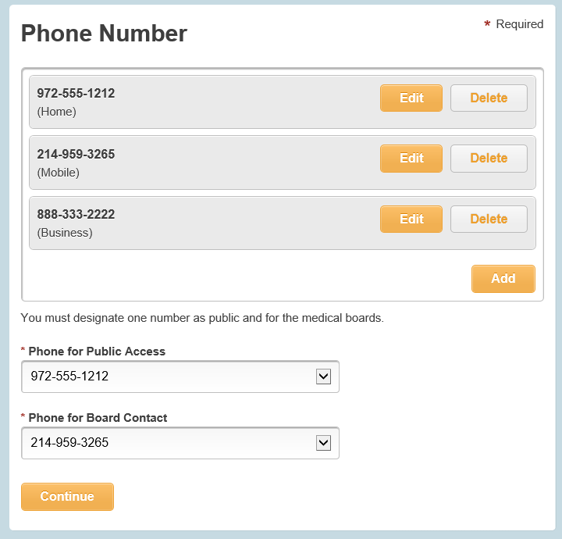
UA Sample – Phone Number Section
Notes:
The phone number section also requires two types of contact information; public access and Board contact.

Slide 30
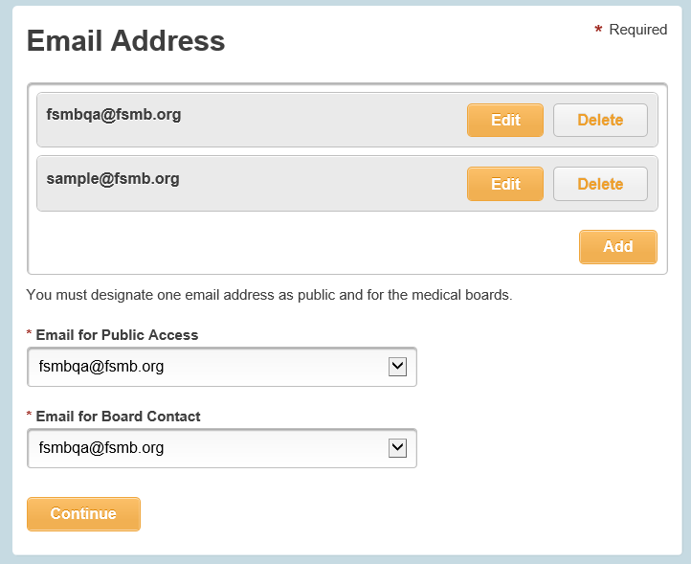
UA Sample – Email Address Section
Notes:
The email address section also requires two types of contact; public access and Board contact.

Slide 31
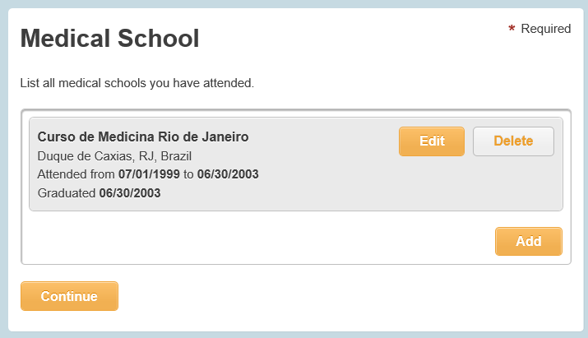
UA Sample – Medical Education Section
Notes:
The medical education section collect information about medical schools that the applicant has attended.

Slide 32
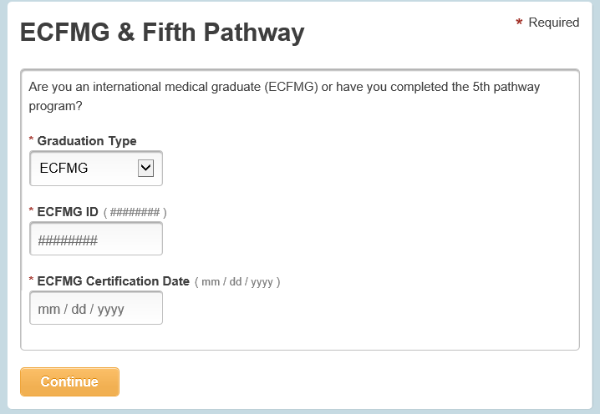
UA Sample – ECFMG & 5Th Pathway Section
Notes:
The ECFMG and Fifth Pathway section becomes available only if an applicant has reported an international medical school(s).

Slide 33
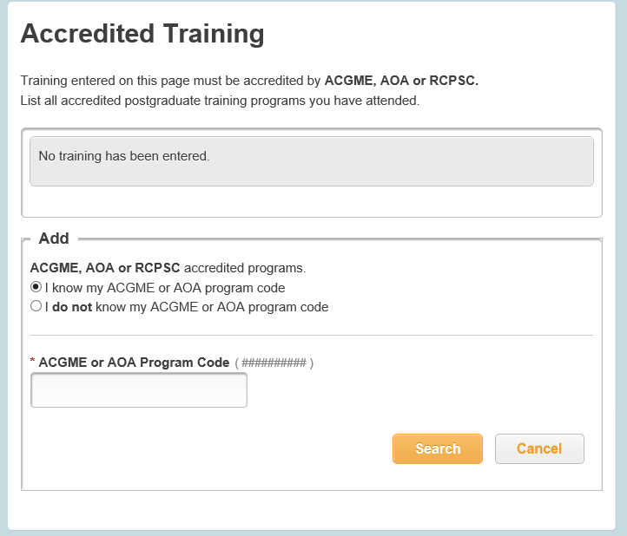
UA Sample – Accredited Training Section
Notes:
The accredited training section collect information regarding the accredited postgraduate training programs the applicants has performed in the U.S or Canada.

Slide 34
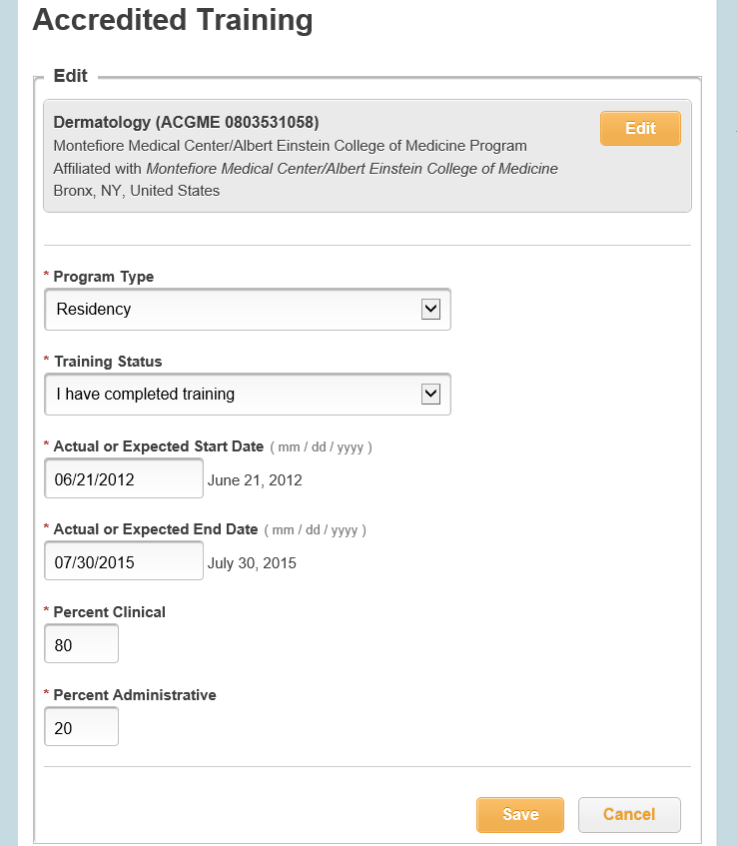
UA Sample – Accredited Training Section
Notes:
Additional details about the postgraduate training programs are to be reported in this section.

Slide 35
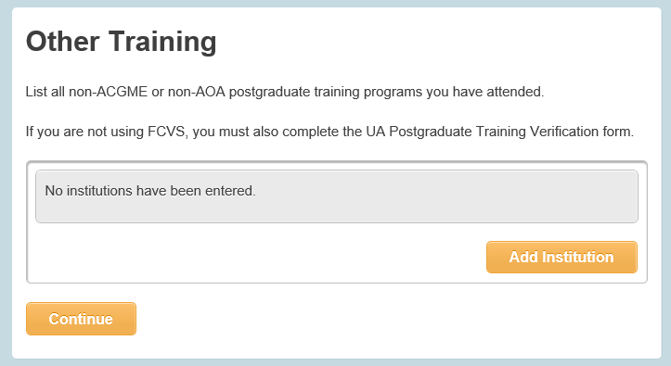
Sample UA- Other Training Section
Notes:
This section collect information regarding all non-ACGME or AOA accredited postgraduate training programs.

Slide 36
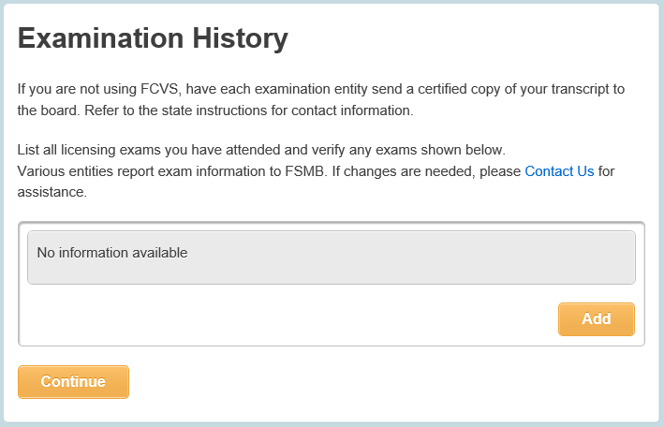
UA Sample – Examination History
Notes:
The Examinations section collects information of all licensing exams taken. The USMLE examination information will automatically pre-populate to this section. All other licensing exams will need to be manually entered in this section.

Slide 37
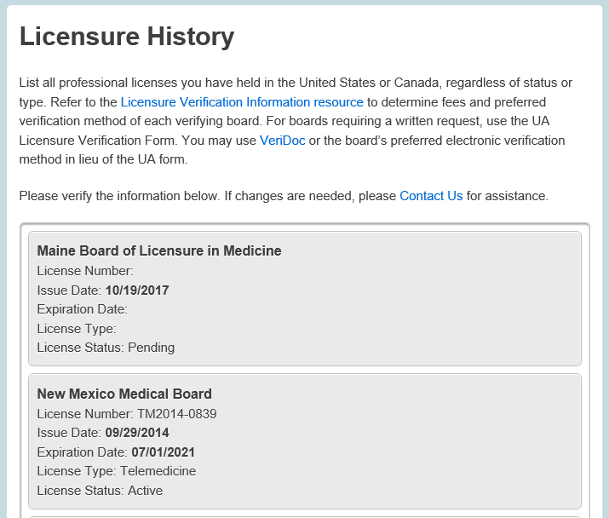
Sample UA – Licensure History
Notes:
Licensure information is reported to FSMB from various licensing jurisdictions and it’s populated to this section automatically.

Slide 38
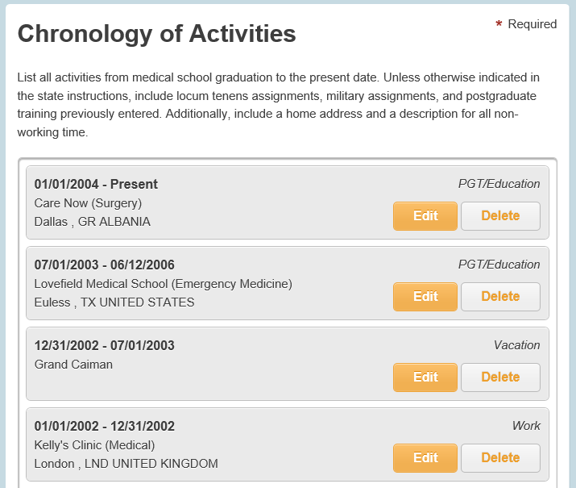
Sample UA – Chronology of Activities
Notes:
The chronology of activities section collects information starting from medical school to the present date without gaps.

Slide 39
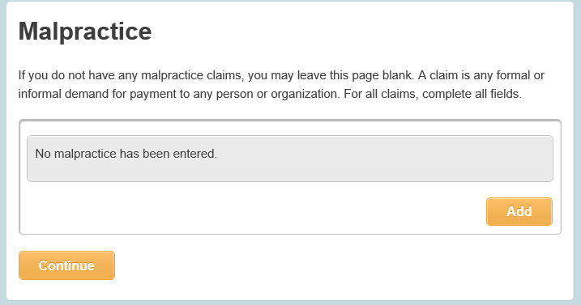
Sample UA – Malpractice Section
Notes:
The malpractice section collects information for all malpractice cases.

Slide 40
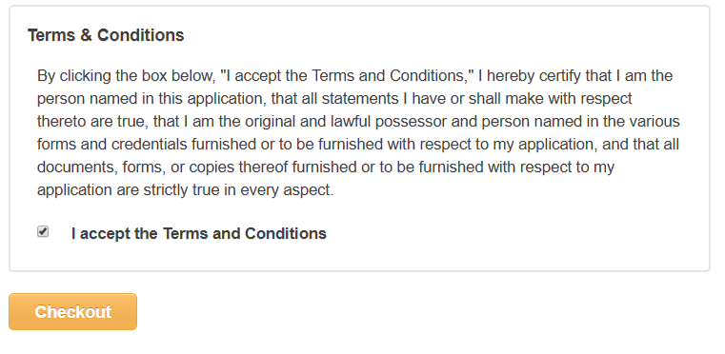
Sample UA – Terms/Conditions
Notes:
After the online information has been reviewed, and the physician has read and accepted the terms and conditions, the application is ready to be submitted by selecting the checkout button.

Slide 41
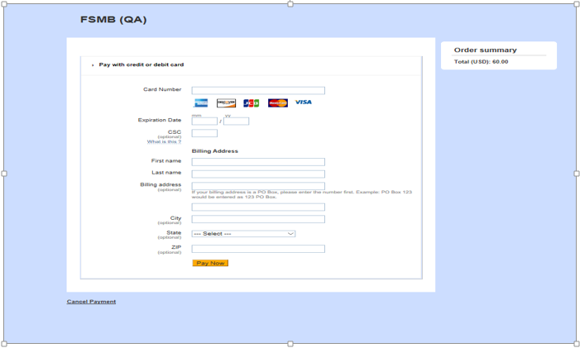
Sample UA – Check Out/Submit
Notes:
If the physician has never used the UA before, the next step will be to go to the checkout page and pay the one-time fee of $60.00. If the physician has used the UA before, this screen will not show up.

Slide 42
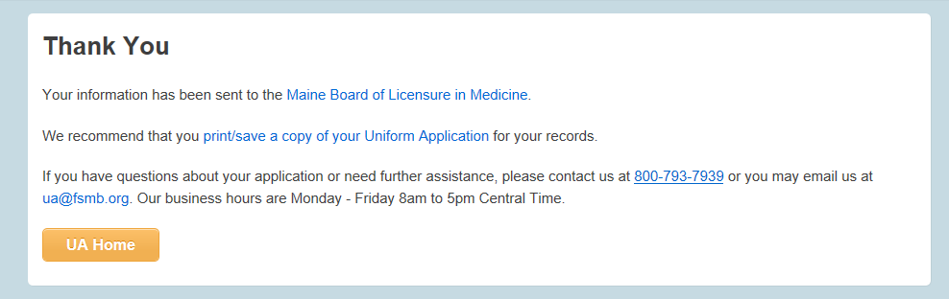
Sample UA - Confirmation
Notes:
Immediately after the application is submitted to a board, the applicant will receive a confirmation screen. From this screen, the applicant can print the UA, or return to the UA home to either log out or submit to another board.

